Slide 1
Bees
By Damian Domino

Slide 2
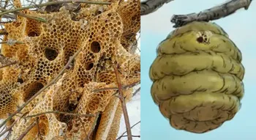
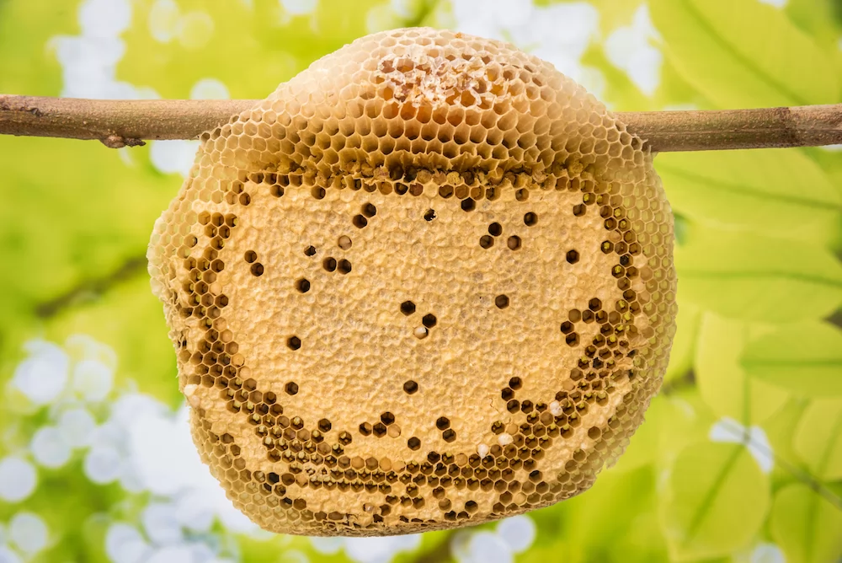
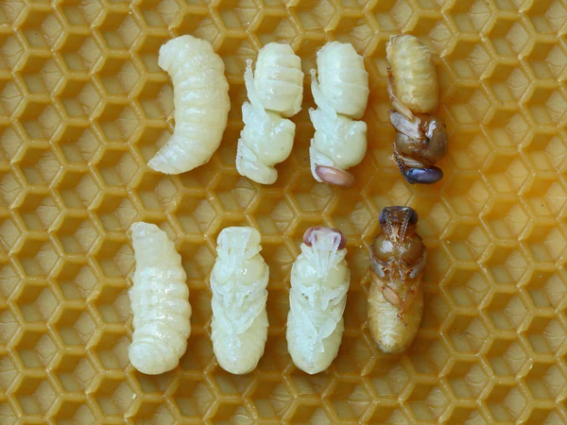
Hives
Home of the bees
Contains:
  Honey
  Bee larvae
  Queen Bee

Slide 3
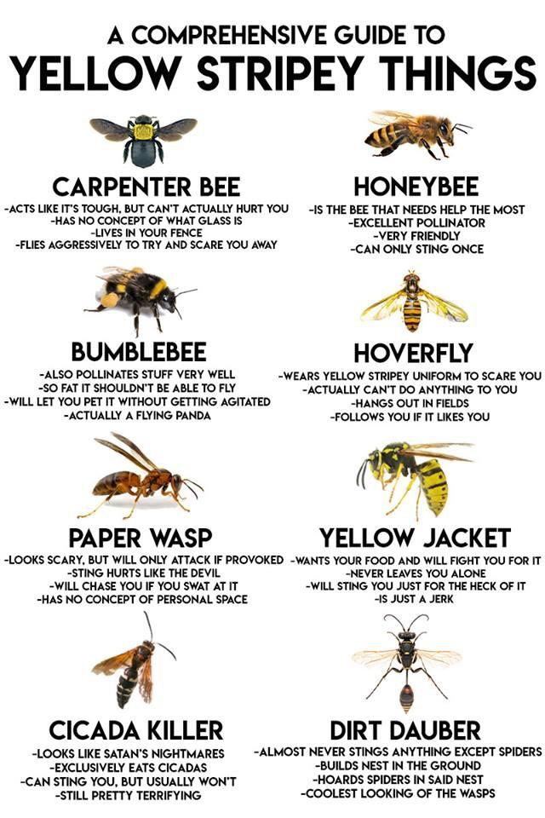
Bees in Nature

